Slide 1
SOEN 384
Management, Measurement and Quality Control http://users.encs.concordia.ca/~s384_2/
Lecture 9
Review of the Software Engineering Measurement
(ISO 15939)
Management Key Area (KA) 1: Initiation and scope definition

Slide 2
Agenda
Review
  Software Engineering Measurement
    6.1. Establish and Sustain Measurement Commitment
    6.2. Plan the Measurement Process
    6.3. Perform the Measurement Process
    6.4. Evaluate Measurement
Exercises
Management Key Area (KA) 1: Initiation and scope definition
Next?
soen384-F15-L9: review of measurement (KA 6). Management KA 1: Scope

Slide 3
Software Engineering Management Subareas (SWEBOK)
Software engineering measurement (1 subarea, based on ISO15939)
  Measurement refers to the assignment of values and labels to aspects of software engineering (products, processes, and resources ) and the models that are derived from them, whether these models are developed using statistical or other techniques.
Software project management process (5 subareas)
  Management process refers to the activities that are undertaken in order to ensure that the software engineering processes are performed in a manner consistent with the organization’s policies, goals, and standards.
soen384-F15-L9: review of measurement (KA 6). Management KA 1: Scope

Slide 4
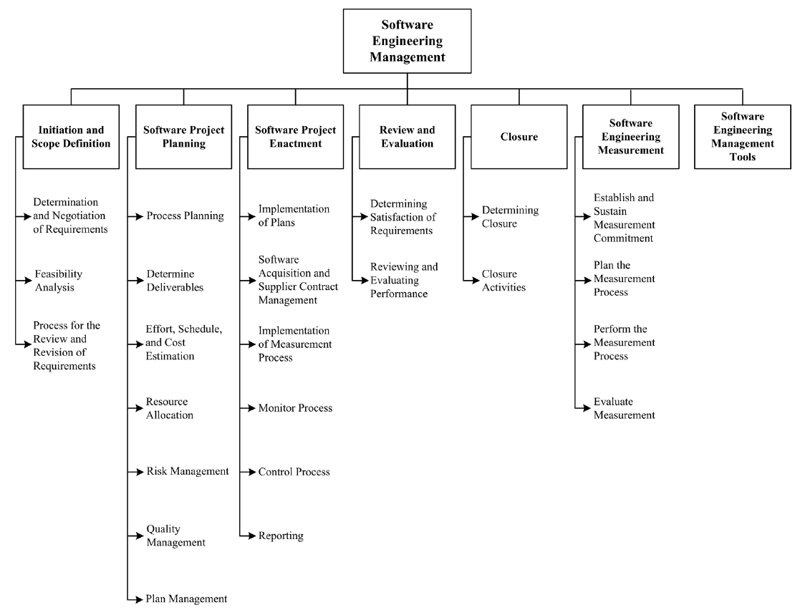
SEM KA
soen384-F15-L9: review of measurement (KA 6). Management KA 1: Scope

Slide 5
6.1. Establish and Sustain Measurement Commitment
(RE: Lecture 5)
Requirements for measurement (Goals)
  Accept the measurement requirements and assign resources
Scope of measurement.
  This may be a single project, a functional area, the whole enterprise, a single site, or a multi-site organization.
  may consist of projects or supporting processes, or both.
Team commitment to measurement.
  allocation of responsibility and duties, training
Resources for measurement.

Slide 6
6.2. Plan the Measurement Process
Identify information needs
  from business goals to measurement goals (Lecture 4)
Select measures
  Apply GQM to derive Questions, Success Criteria, Indicators, Measures (see lecture 5)
  Define data collection rules (for instance, rules for counting logical SLOC – H1), analysis (lecture 3, H2), and reporting procedures (Assignment 1)
Provide resources for measurement tasks.
SOEN390 Project Measurement Process – Lecture 5
  Measuring Overall Customer Satisfaction
  Defects Management
  Code quality trends
soen384-F15-L9: review of measurement (KA 6). Management KA 1: Scope

Slide 7
6.3. Perform the Measurement Process
Integrate measurement procedures with relevant software processes (Lecture 5)
Collect data, analyze data and develop reports (Assignment 1, Lecture 5)
  The results of this analysis are typically indicators such as graphs, numbers, or other indications that will be interpreted, resulting in conclusions and recommendations to be presented to stakeholders
Communicate results to the measurement process owner (Lecture 5)
soen384-F15-L9: review of measurement (KA 6). Management KA 1: Scope

Slide 8
6.4. Evaluate Measurement
Evaluate information products and the measurement process
  Did we select the right measures? (representational theory of measurement, lecture 6)
  Are the statistical analysis methods meaningful? (lecture 6)
Identify and communicate potential improvements.
soen384-F15-L9: review of measurement (KA 6). Management KA 1: Scope

Slide 9
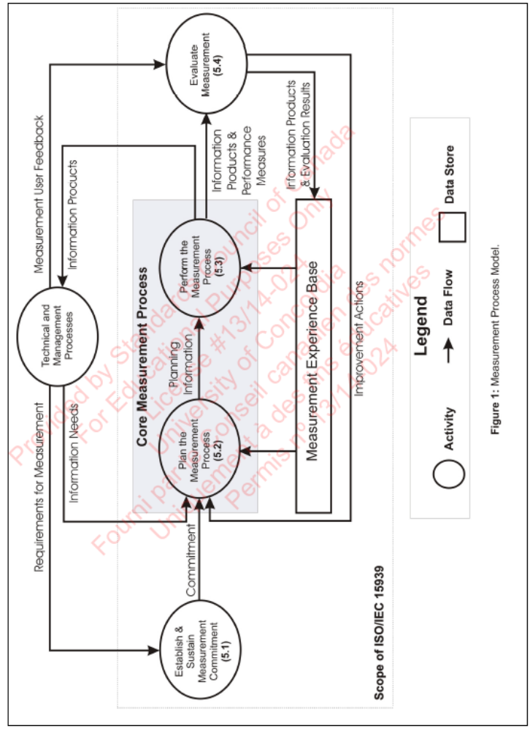

Measurement Process Model
soen384-F15-L9: review of measurement (KA 6). Management KA 1: Scope

Slide 10
ToDo:
Read ISO standard 15939
soen384-F15-L9: review of measurement (KA 6). Management KA 1: Scope

Slide 11
Quality of collected data
Two most important criteria of quality OF measurement data:
  Validity
    Counterpart in traditional quality engineering is accuracy
  Reliability
    Counterpart in traditional quality engineering is precision
Theoretically, a measure is valid if it reflects the real meaning of the concept under consideration
Notes:
How good are the measurement scales and the measurement data?
Do they really measure the concept we want to measure and doing so with good quality?

Slide 12
Reliability
Goal: error-free measurement.
Possible?
Reliability: Consistency of a number of measurements taken using the same measurement method on the same subject
Can be expressed in terms of the size of the standard deviations of the repeated measurements
  The smaller the variation, the more reliable the measurements
Never attained in any discipline of scientific investigation
Notes:
The variance is a measure of how spread out a distribution is. It is computed as the average squared deviation of each number from its mean.
The formula for the standard deviation is very simple: it is the square root of the variance. It is the most commonly used measure of spread.
An important attribute of the standard deviation as a measure of spread is that if the mean and standard deviation of a normal distribution are known, it is possible to compute the percentile rank associated with any given score.

Slide 13
Homework 1&2: data analysis discussion
Most students used different rules for counting SLOC.
  Some included comments, whitespace, braces, libraries, etc. and some didn’t; this can cause measurements of productivity to be biased
The programming language used needs to be considered as well.
Another problem may arise with inaccuracy in counting the time needed to perform the task.
In order to use a control chart to analyze and interpret the coding productivity data the dataset has to be normally distributed
  Normalize the data (employ an appropriate transformation to this non-normal dataset)
  A greater number of data points will help the data to approach normality.

Slide 14
Agenda
Review
  Software Engineering Measurement
    6.1. Establish and Sustain Measurement Commitment
    6.2. Plan the Measurement Process
    6.3. Perform the Measurement Process
    6.4. Evaluate Measurement
Exercises
Management Key Area (KA) 1: Initiation and scope definition
Next?
soen384-F15-L9: review of measurement (KA 6). Management KA 1: Scope

Slide 15
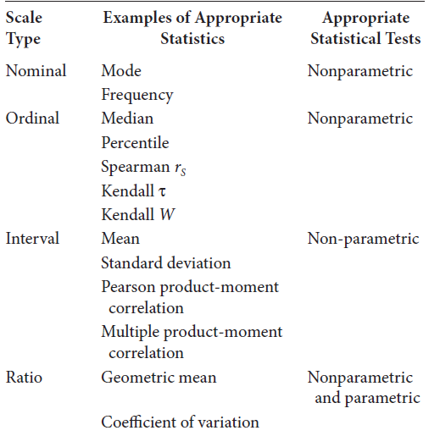
Summary of measurement scales and statistics relevant to each
soen384-F15-L9: review of measurement (KA 6). Management KA 1: Scope

Slide 16
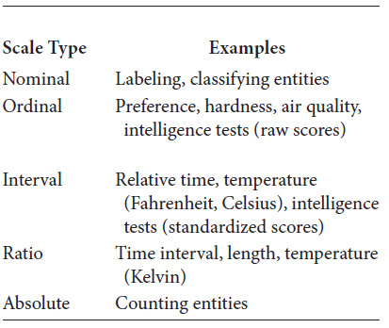
Examples
soen384-F15-L9: review of measurement (KA 6). Management KA 1: Scope

Slide 17
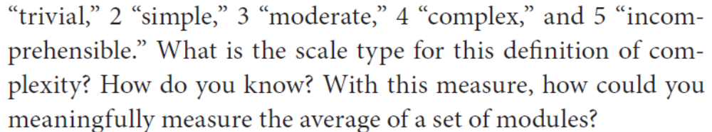
Exercise 1
Answer 1: ordinal. Why?
There is no unit of measurement for complexity => only two scale types may be considered: Nominal and Ordinal
The categories are ranked (ordered) from least to most complex => cannot be Nominal scale type => it is ordinal scape type
Answer 2: the meaningful measure of central tendency is median (see the note for this slide)
soen384-F15-L9: review of measurement (KA 6). Management KA 1: Scope
Notes:
In statistics, a central tendency (or, more commonly, a measure of central tendency) is a central or typical value for a probability distribution. It may also be called a center or location of the distribution. Colloquially, measures of central tendency are often called averages.

Slide 18
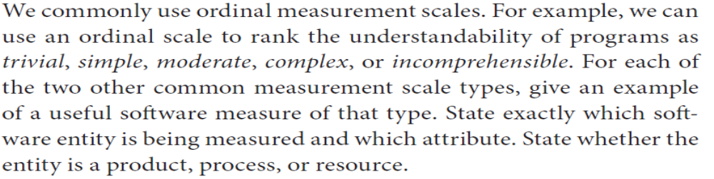
Exercise 2
Two other common measurement scale types: Ratio, Absolute
Example of a useful software measure of Ratio type:
  Entity: code, Attribute: length. Measure: LOC (it is Ratio type because there is an absolute 0 meaning no attribute (no length), there is a unit of measurement Line of Code, and there is another unit of measurement KLOC (thousands of lines of code).
Example of a useful software measure of Absolute type:
  Entity: SRS, Attribute: defects found during inspection. Measure: #Defects. (it is Absolute type because there is an absolute 0 meaning no attribute (no defects found) and there is a unique unit of measurement - defect)
soen384-F15-L9: review of measurement (KA 6). Management KA 1: Scope

Slide 19
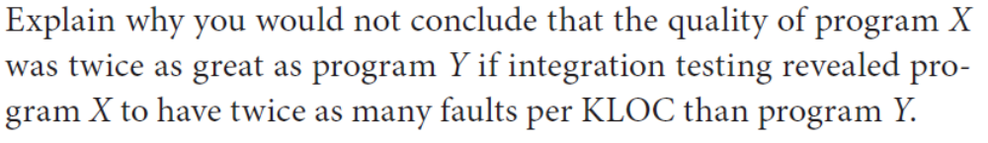
Exercise 3
Entity: program, Attribute: Quality. Quality of a program is Ordinal type: there is no measurement unit of quality, but we can order programs in terms of their quality. Therefore, the statement “quality of X is twice as great as quality of Y” is not meaningful.
On the other side, Faults per KLOC measure is Ratio type (there is an absolute zero indicating no faults, there are more than one units of measurement: Faults per KLOC and faults per LOC.) If we assume the statement to be correct ,that is, Faults per KLOC to be a measure of program quality, then the absolute zero (zero faults per KLOC) would have to indicate no quality, which is wrong.
soen384-F15-L9: review of measurement (KA 6). Management KA 1: Scope

Slide 20
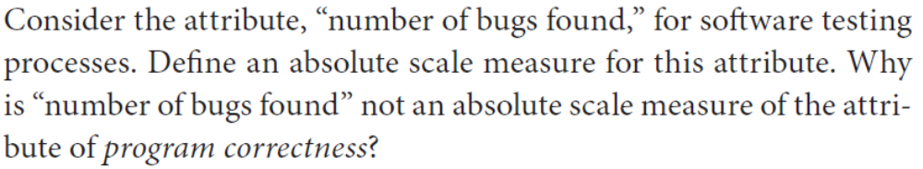
Exercise 4
Entity: Program, Attribute: number of bug found, Absolute scale measure: #Defects
Entity: program, Attribute: Program Correctness. Program Correctness is Ordinal type: there is no measurement unit of Program Correctness, but we can order programs in terms of their Program Correctness. Number of bugs found cannot guarantee a defect-free program or a correct program that does exactly what it is intended to do, no more and no less. Moreover, Program Correctness is a complex notion and will depend not only on the number of bug found, but also on a mathematical proof of correctness, on the functional suitability of the program (see ISO 25010), etc. Therefore, #defects cannot be an absolute scale measure of Program Correctness.
soen384-F15-L9: review of measurement (KA 6). Management KA 1: Scope

Slide 21
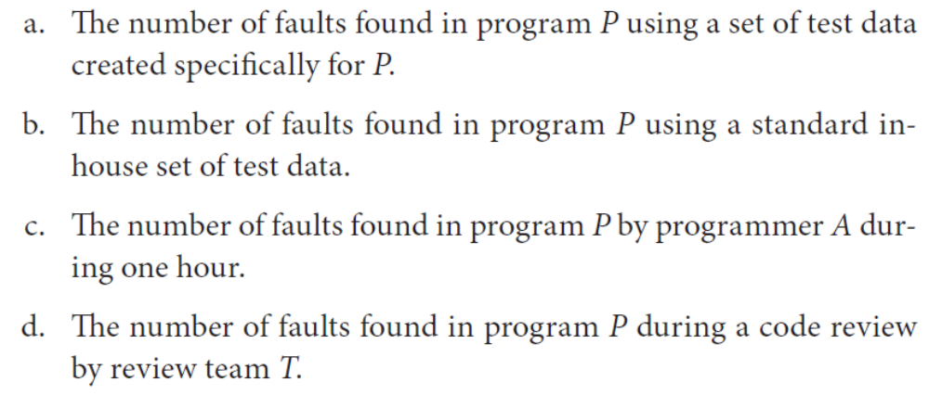
Exercise 5
Please ignore this exercise because of its ambiguity. For those of you who are curious about the answers a, b, c, d:
it’s the same Entity: Program, same Attribute: the number of faults found.
soen384-F15-L9: review of measurement (KA 6). Management KA 1: Scope

Slide 22
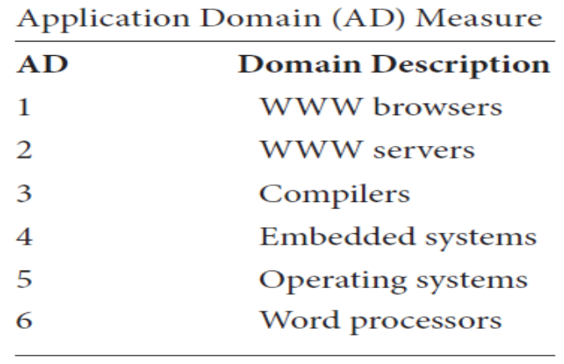
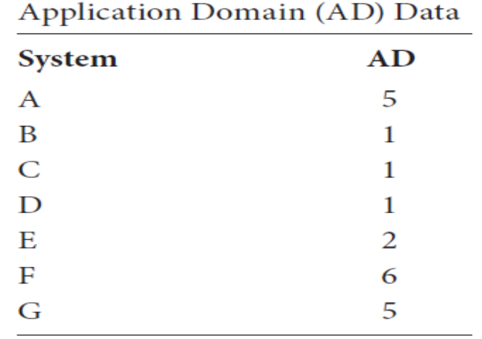
Exercise 6
Nominal
Mode
Mode of applications A-G: 1
soen384-F15-L9: review of measurement (KA 6). Management KA 1: Scope

Slide 23


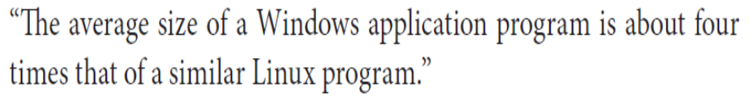
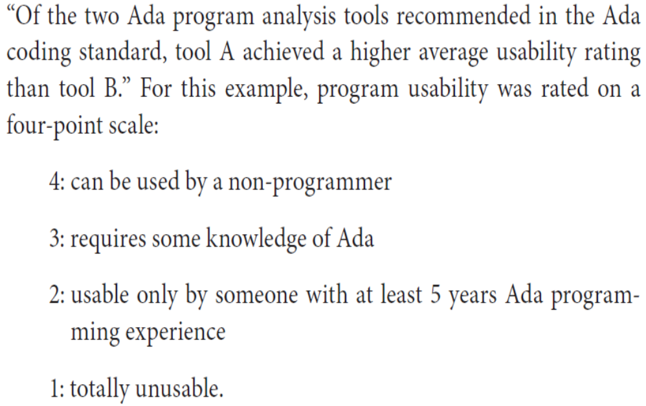
Exercise 7: Meaningfulness v.s. Truth Value
Not meaningful because failure is Ordinal type, ratio of measurement data is not meaningful
Meaningful (and false)
meaningful because program length is Ratio type therefore ratio of measurement data meaningful
Entity: Program, Attribute: Usability. Usability is Ordinal s type (no unit of measurement, but we can rank programs in terms of their usability). The Meaningful measures of central tendency (average) in this example are median or node. Arithmetic mean cannot be used as a measure of central tendency for usability.
soen384-F15-L9: review of measurement (KA 6). Management KA 1: Scope

Slide 24
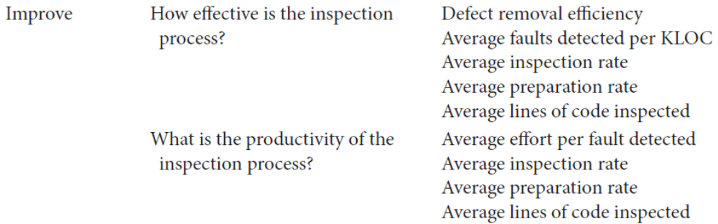
Examples of GQM: improve code inspection process (AT&T)
(see also Fenton’s book, p. 102, table 3.3)

Slide 25
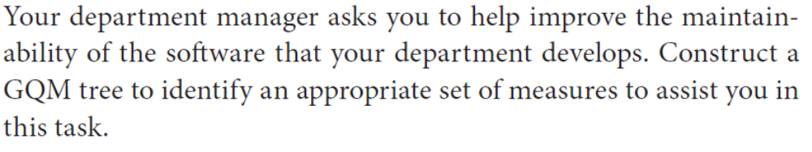
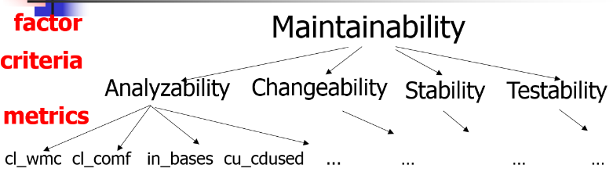
Exercise 8 on GQM: maintainability
soen384-F15-L9: review of measurement (KA 6). Management KA 1: Scope

Slide 26
Software Engineering Management Subareas (SWEBOK)
Software engineering measurement (1 subarea)
Software project management process (5 subareas)
Why two different subjects (management and measurement) are combined?
  Management without measurement, qualitative and quantitative, suggests a lack of rigor
  measurement without management suggests a lack of purpose or context.
soen384-F15-L9: review of measurement (KA 6). Management KA 1: Scope

Slide 27
Questions?
…
soen384-F15-L9: review of measurement (KA 6). Management KA 1: Scope

